Slide 1
Dashboard of an Electric Vehicle
Team members:
1. Shetty Roshan Ravi - 4nm18ee051
2. Sreedev S. Nair - 4nm18ee058
3. Rishikesh Kumar C. - 4nm18ee040
4. Aadi Thejaswi - 4nm18ee001
Project Guide: Dr. Suryanarayana K.

Slide 2
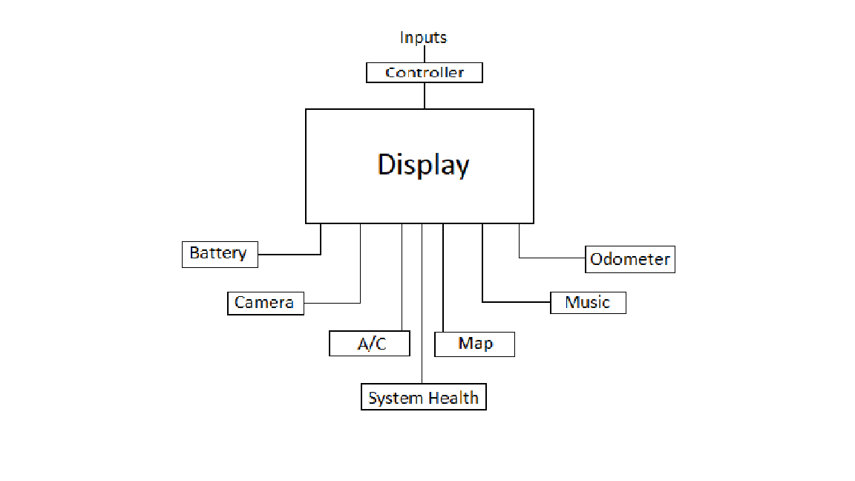
Block Diagram:

Slide 3
Working Principle:
In this project we are developing a HMI display control unit using
Weintek 8071IP to control various features of the Electric Vehicle. The
features include Battery percent (voltage) monitor, A/C controller,
Media player, Camera monitor, odometer and System health checker.
Here we will take inputs from multiple circuits pertaining to different
features of the Electric vehicle, process it and try to display it on the
Weintek 8071IP display.

Slide 4
Front Page:

